Slide 1
Optimisation of Heating in Closed Indoor Spaces
CL 246 - Course Project | G15

Slide 2
Problem Statement
Reduction Of Heat Load Of Households Using Evaporative Cooling
solved by
Lowering energy consumption in large buildings by reducing the heating load, using a combination of sustainable methods
Notes:
Original problem statement - “Lowering costs and environmental impacts of HVAC systems by optimising for efficiency and integrating one or more sustainable methods driven by renewable resources to enhance design”
Why have we changed it? - because the earlier scope was way too wide, and we needed a more refined question to come up with a specific solution
The user pain point still remains the same - high energy costs and high environmental impact - we understood that trying to fix energ sources requires much more technical expertise, hence we focus on relatively simpler problems.

Slide 3
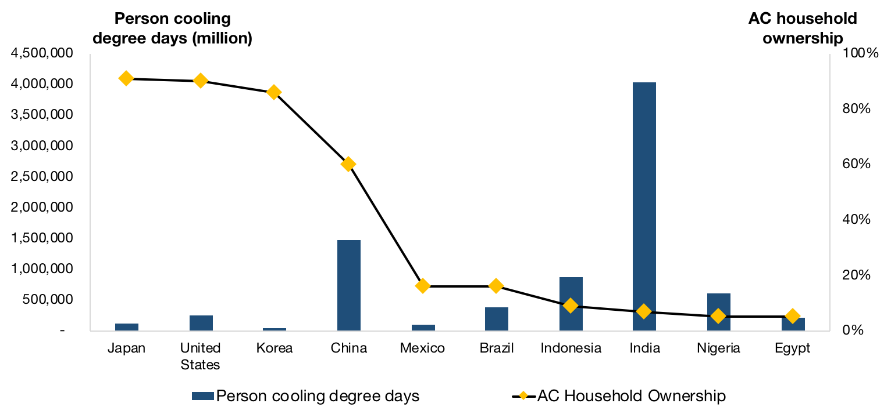
Need for this project
With rising energy requirements in tropical countries such as India, it is important to optimise cooling while lowering energy consumption.

Slide 4
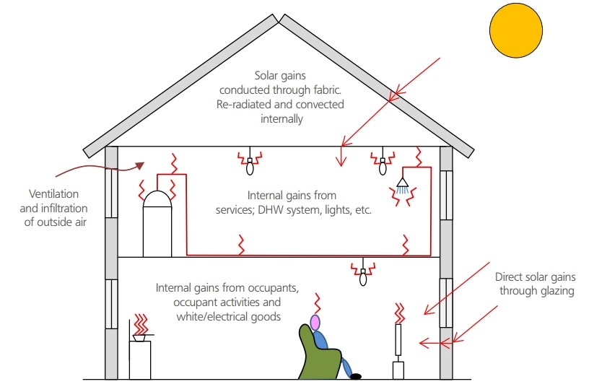
Sources of heat gain in a house
Heat Conduction to building Envelope
Heat gain through ventilation and airflow through the room
Casual heat gain due to occupants
Notes:
Electricity requirement is quite high in modern houses esp in hot and dry places , leads to huge amount of energy cost therefore reduction of heat load by restricting the entering heat flux can be a efficient mechanism.

Slide 5
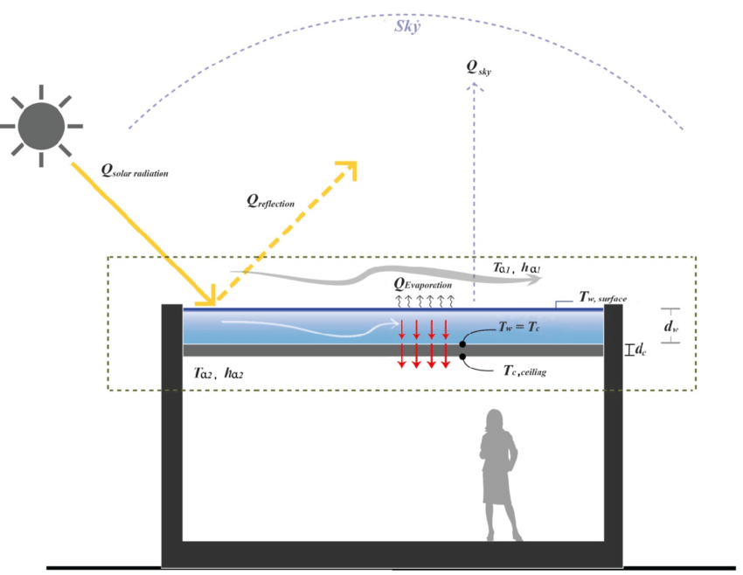
Evaporative Roof Cooling
An approach to reduce heat flux into buildings through the roof.
Film of water is maintained above the roof by using water absorbent material.
Latent heat of vaporization is the main mechanism of reducing load.
Notes:
60% of heat flux entering house is through roof.

Slide 6
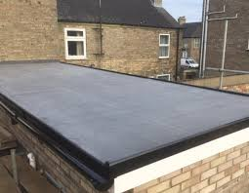
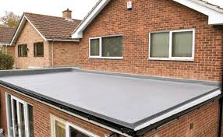
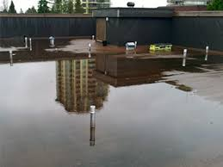
System
These are indicative images that reflect the way a roof based evaporative cooling system would appear physically. The system would consist of the room as a control volume, with the liquid layer on the roof and sun as the major source of heat flux.

Slide 7
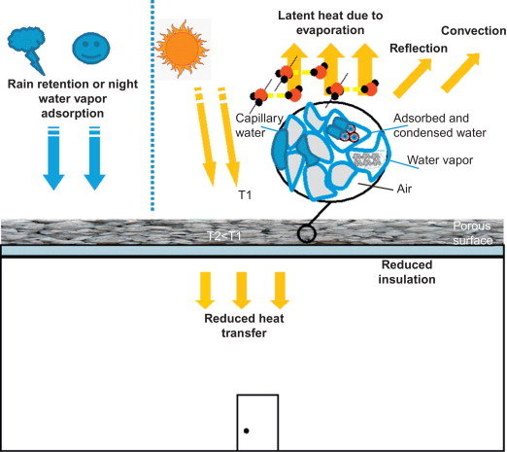
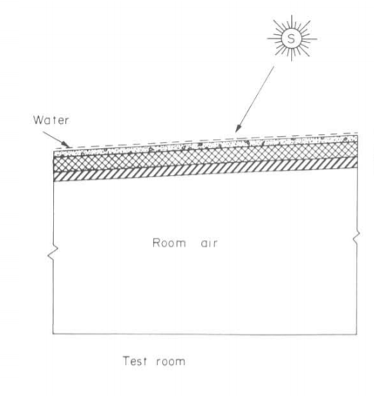
Actual Structure of
Evaporative cooling
ventilation/cooling device
Notes:
Sunlight exposure is for 6 hours

Slide 8
The Problem
Estimate and compare the heat flux through the roof of a house in a place with hot and dry conditions in two cases:
Normal conditions with just a three layered roof exposed to the solar radiation and wind convection during afternoon when the solar radiation can be assumed to constant (invariable with time).
Now a thin water layer is added to the roof (thin enough to neglect temperature variation along the thickness of the water layer) which uses some of the heat incident into evaporation . This phenomenon of reduction of inlet heat flux in the house is known as evaporative cooling.

Slide 9
Considerations In The Problem
Ambient room temperature i.e. inside room temperature is 27 deg.centigrade
Temperature outside varies between 35 deg centigrade and 50 deg centigrade, and is constant and uniform at any point of time
Heat transfer majorly involves conduction through roof, convection through air and water and conduction through the roof layers
Solar radiation is incident for six hours in a day
The control volume is cuboidal

Slide 10
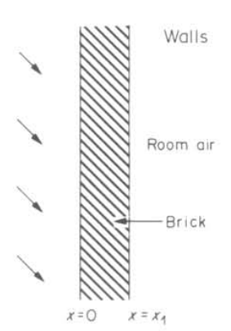
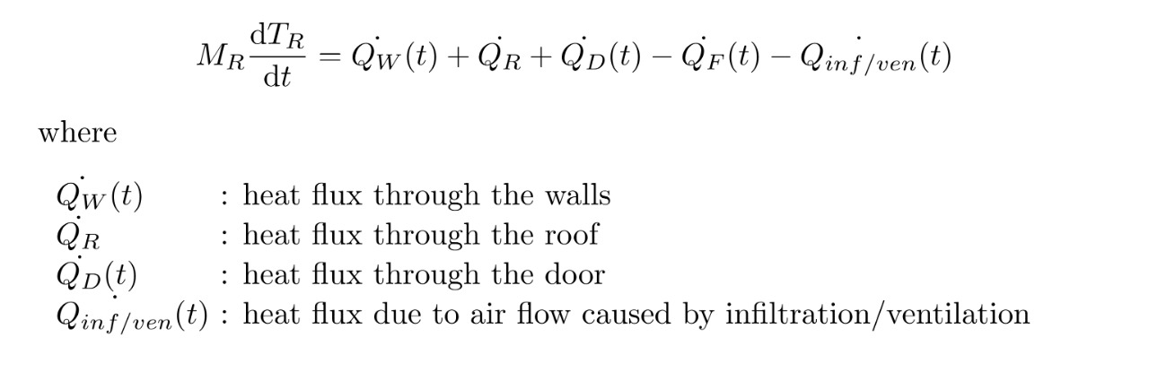
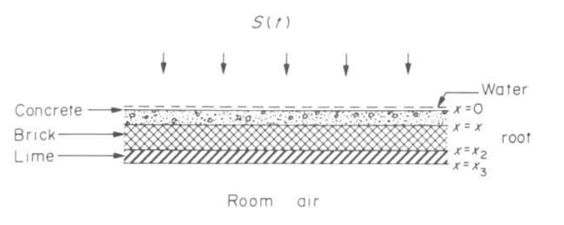
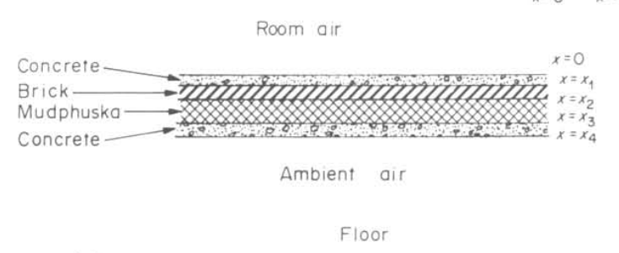
Heat Flux Balance Through Room
(Room as CV)

Slide 11
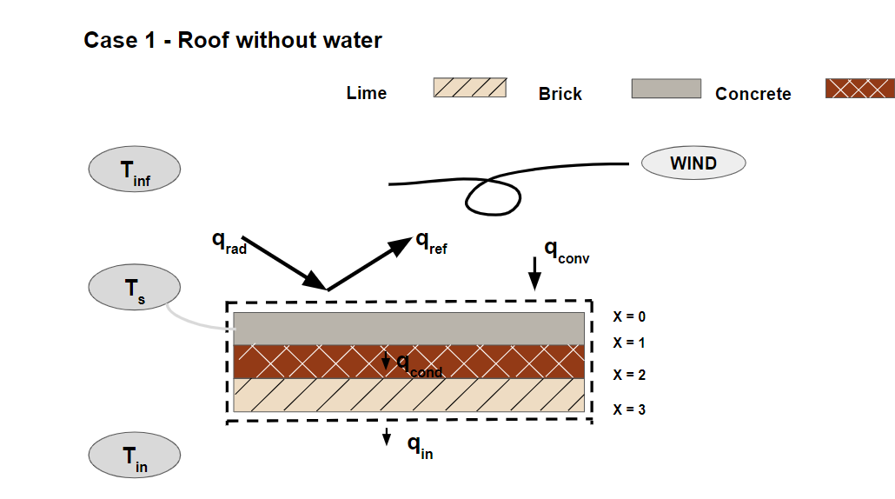
Considerations In The Problem
Basic Integral Balance Equation for case A:
Where,
q_{rad} - radioactive flux
q_{conv} - convective flux
q_{net} - net heat flux
q_{cond} - conductive heat flux
q_{in} - influx of heat
q_{rad} + q_{conv}- q_{ref} = q_{cond}
q_{cond} = q_{in}
CASE A - indicative heat balance for roof without a water layer
Lime
Concrete
Brick

Slide 12
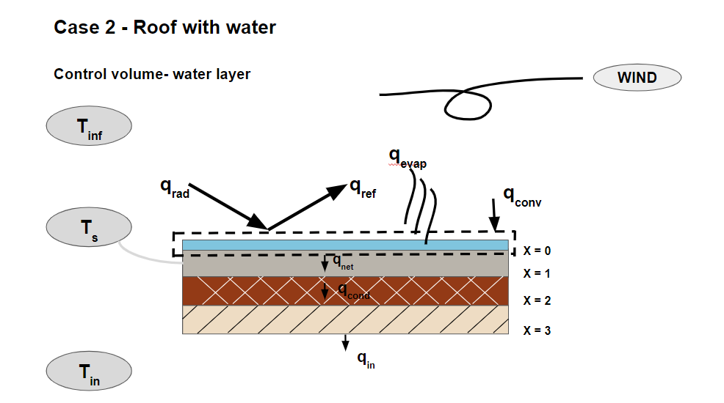
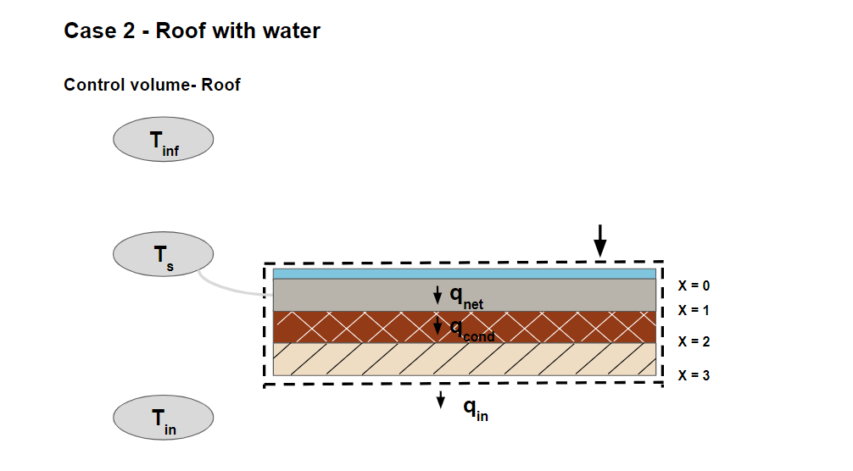
Integral Balance
Basic Integral Balance Equation for case B:
Where,
q_{rad} - radioactive flux
q_{conv} - convective flux
q_{net} - net heat flux
q_{cond} - conductive heat flux
q_{in} - influx of heat
q_{evap}- evaporative heat flux
q_{ref} - reflective heat flux
q_{net} = q_{cond} = q_{in}
q_{net} = q_{rad} + q_{conv} - q_{ref} - q_{evap}
CASE B - indicative heat balance for roof with water layer with two CVs - one for only water layer and one for entire roof (All layers)

Slide 13
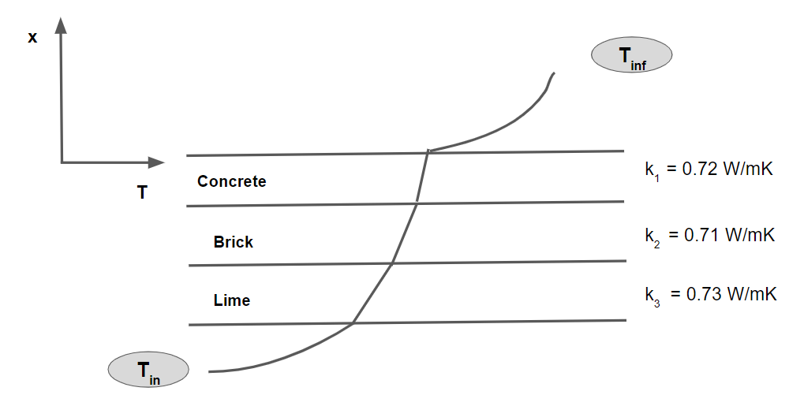
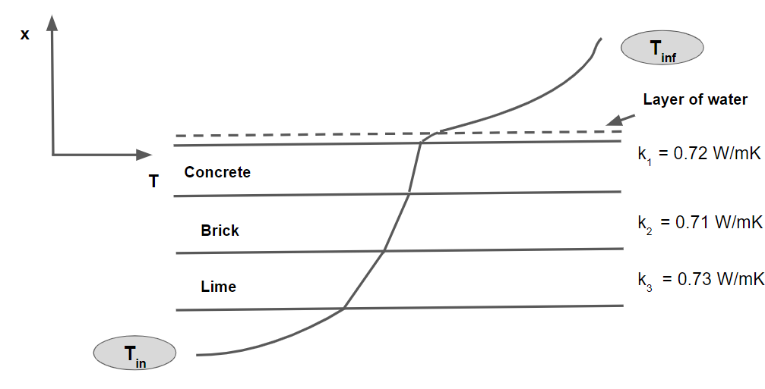
Qualitative Temperature Profile
Roof directly exposed to the radiation
Layer of water over the roof surface
(to allow evaporative cooling)

Slide 14
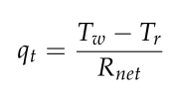
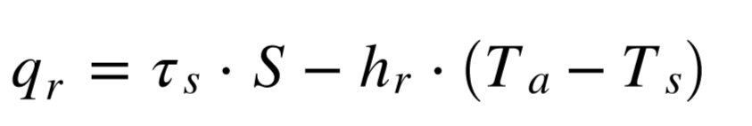
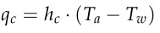

Heat Transfer Modes (rough estimates 1/2)
Case 1: No Water
Layer Present
Total heat transfer
Approximate:
Outside temperature (Ta): 310K
Roof surface temp. (Ts): 314K
q_t (approx) = 15 W/m^2
Radiation heat transfer
Convection heat transfer
q_r (approx) = 1343 W/m^2
h_c (approx) = 330 W/m^2
q_c (approx) = -1330 W/m^2

Slide 15
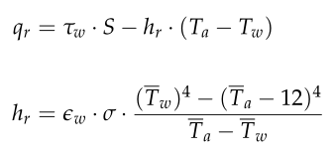
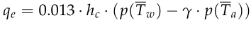
Heat Transfer Modes (rough estimates 2/2)
Case 2: Water
Layer Present
Total heat transfer
Approximate:
Outside temperature (Ta): 310K
Water surface temp. (Tw): 306K
q_t (approx) = 6 W/m^2
Radiation heat transfer
Evaporation heat transfer
Convection heat transfer
q_r (approx) = 786 W/m^2
q_e (approx) = 76 W/m^2
h_c (approx) = 19 W/m^2
q_c (approx) = 841 W/m^2

Slide 16
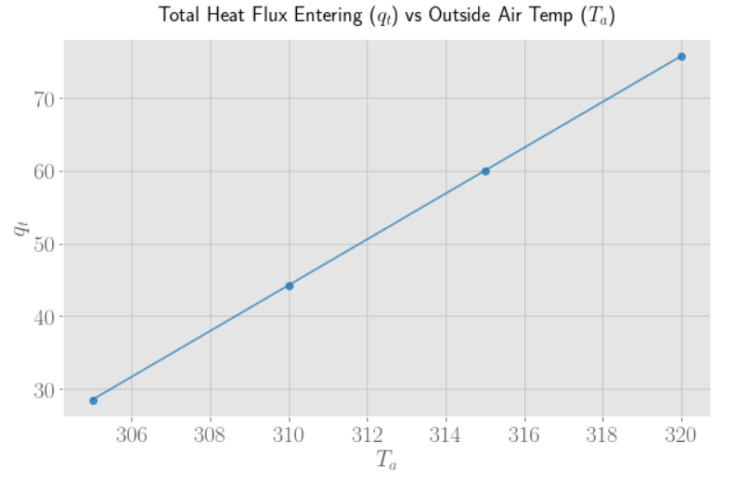
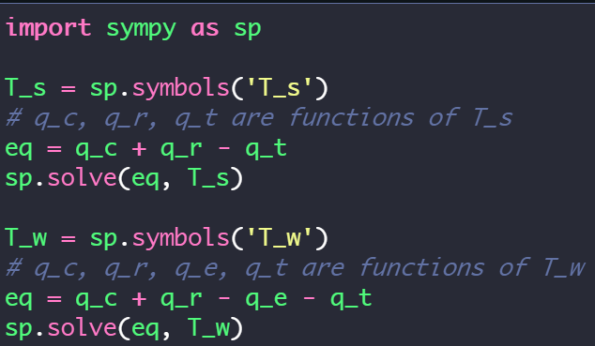

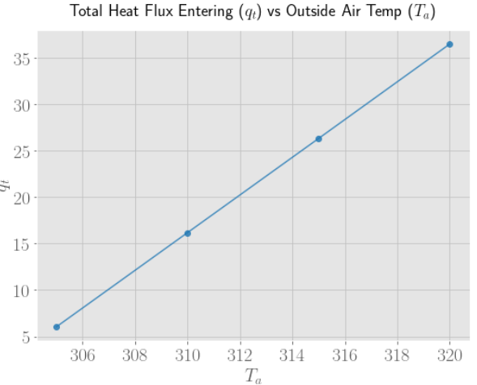
Solving the equations
SymPy was used to create symbolic equations and later solve them.
For the bare surface, roof surface temperature was taken as a variable.
For the case containing a water layer, water surface temperature was a variable.

Slide 17
Conclusion and Impact
The drastic reduction evident here indicates that this might be a viable method to achieve our original goal of reduction in energy and electrical costs, even accounting and/or revising for the assumptions considered.
Temperature of outside air (T_{inf} in K) | Without Water Layer (W/m²) | With Water Layer (W/m²)
305 | 28.5 | 6.0
310 | 44.3 | 16.2
315 | 60.0 | 26.3
320 | 75.8 | 36.5

Slide 18
Conclusion and Impact
Energy required to evaporate one litre of water - 0.67 kilowatt-hour (2.412 MJ)
Energy spent in one hour of AC cooling - 3.571 kilowatt-hour (12.86 MJ)
Therefore, 5.5 litres of water evaporating is equivalent to energy usage of one hour of air conditioning
Advantages:
Low cost of setup
Negligible maintenance and operational costs

Slide 19
THANK YOU

